Slide 1
Kaleidoscope U
Brought to you by Dan Land - Arris Studios

Slide 2
History of Kaleidoscopes
“Kaleidoscope” is a combination of Greek words, KALO, EIDO, SCOPOS meaning beautiful-forms-viewer.
Greek mathematician Ptolemy contemplated effects of abutting mirrors
Egyptians placed 2 or 3 slabs of highly polished limestone at different angles and watched mandalas of human dancers
Kaleidoscopes were invented by Sir David Brewster (1816)
Charles G. Bush brought kaleidoscopes to America in 1870
Cozy Baker started Kaleidoscope Society in 1986

Slide 3
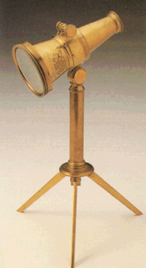
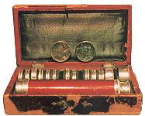
Sir David Brewster
Invented the kaleidoscope in 1816 (patented in 1817). Made no money from his invention because of a mistake in his patent.
Scottish child prodigy, built a telescope at age 10
Started studying for clergy at age 12, earning Master of Arts at age 19. Dropped out of ministry after 1st sermon
Invented the Fresnel mirror (polygonal lens built in circular segments) which is used in all lighthouses (1811)
Awarded for theories of polarized light. Brewster’s Angle – simple way to calculate angle light must strike subject for maximum polarization. Theory still used for radio signals to microscopes. Central to fiber optics, lasers, and study of meteorology and cosmetology.

Slide 4
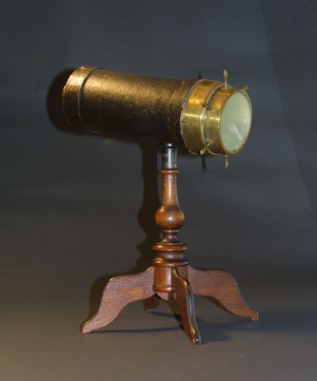
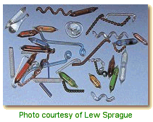
Charles G. Bush
Started Kaleidoscope fad in America
Born in Prussia, moved to Plymouth, MA
Rope maker using microscopes to examine the fibers
Started making kaleidoscopes in 1870
Known for his liquid filled objects (ampules) containing bubbles that caused continuous movement
Patents: ampules, interchangeable object cell, color wheel for scopes, 4 legged stand
Notes:
Charles G(ustavos) Busch – dropped the C for his patents
parlor scopes
Made over 5000 scopes
Originally sold for $2, today 2-4 K
Scopes typically held 35 objects of which 1/3rd were liquid filled
While given credit for liquid filled objects, Brewster in 1819 mentions “differently moving fluids enclosed and moving in small vessels of glass will make the finest transparent objects for the kaleidoscope”. Which is why these objects can be found in early European scopes.

Slide 5
Cozy Baker
Started the Brewster Kaleidoscope Society in 1986 at the 2nd kaleidoscope exhibit at the Strathmore Hall Art Center (Bethesda, Md)
Purchased her first kaleidoscope in 1982 at a gift shop in Nashville, TN (made by Doug Johnson)
1989 organized the first convention
Cozy Baker Award is a special award that goes to an artist who is responsible for the development of innovations that set the standard for the aesthetic of the art of kaleidoscope
Never designed a kaleidoscope
Wrote 7 books about kaleidoscopes

Slide 6
Land’s Barber Shop
Home of the “help” I’m trapped in a kaleidoscope feeling…
Mirrors lined both sides of the shop and while sitting in the chair I would try to count how many reflections I could see of myself.
Notes:
Charles G(ustavos) Busch – dropped the C for his patents
parlor scopes
Made over 5000 scopes
Originally sold for $2, today 2-4 K
Scopes typically held 35 objects of which 1/3rd were liquid filled
While given credit for liquid filled objects, Brewster in 1819 mentions “differently moving fluids enclosed and moving in small vessels of glass will make the finest transparent objects for the kaleidoscope”. Which is why these objects can be found in early European scopes.

Slide 7
Kaleidoscope Uses
Enjoyment of beautiful images
Design of tapestries, rugs, carpets
Education
Learning Geometry
Stress Reduction
Meditation device (mandalas) increasing creativity
Chroma (color) therapy – colors affect emotions
Mandalas – symbol of oneness with the universe

Slide 8
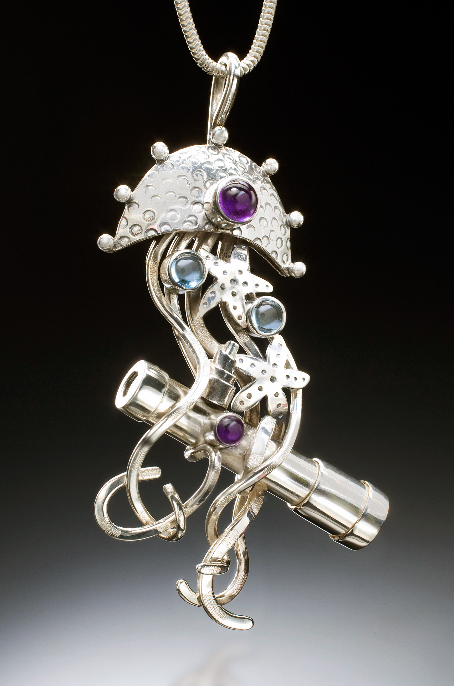
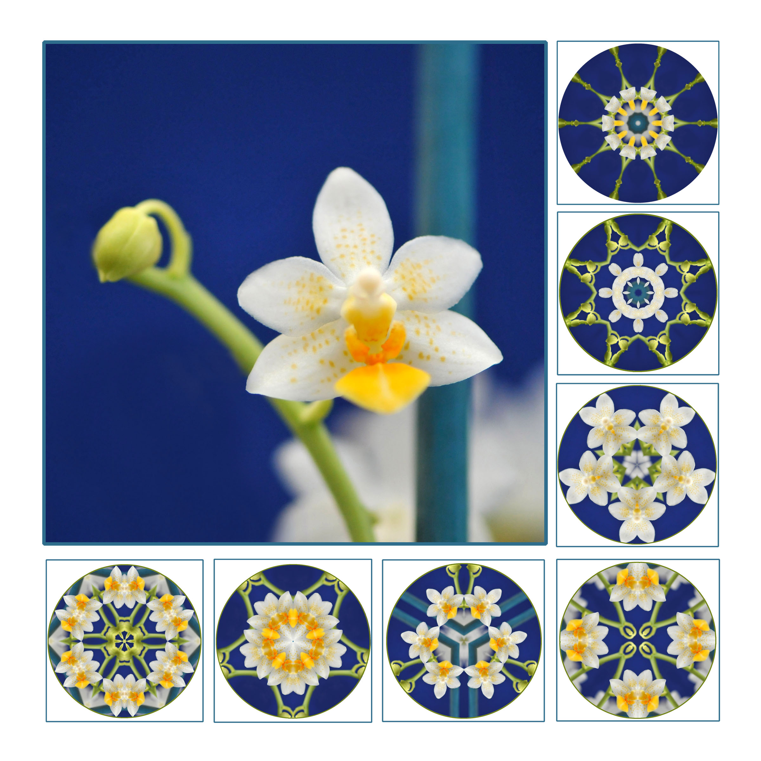
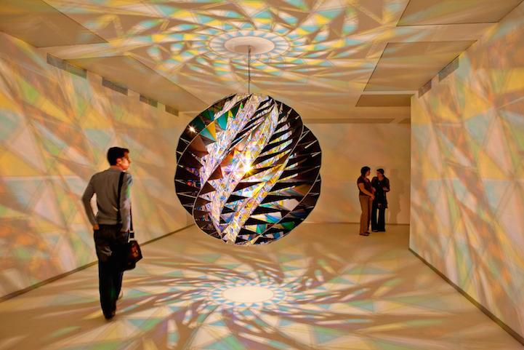
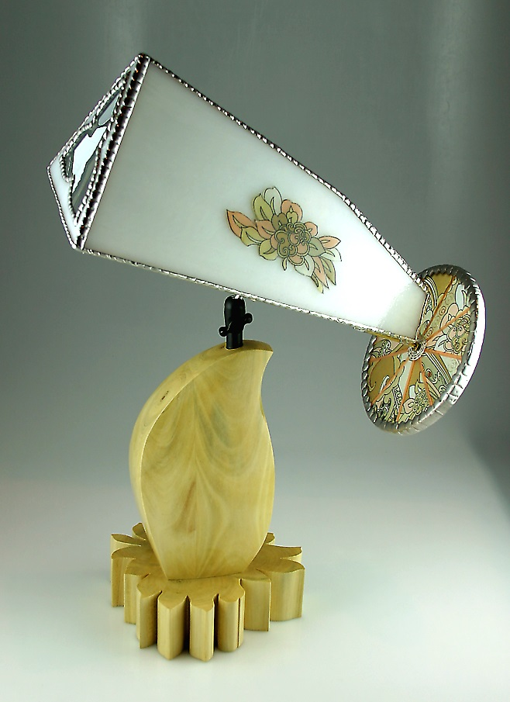
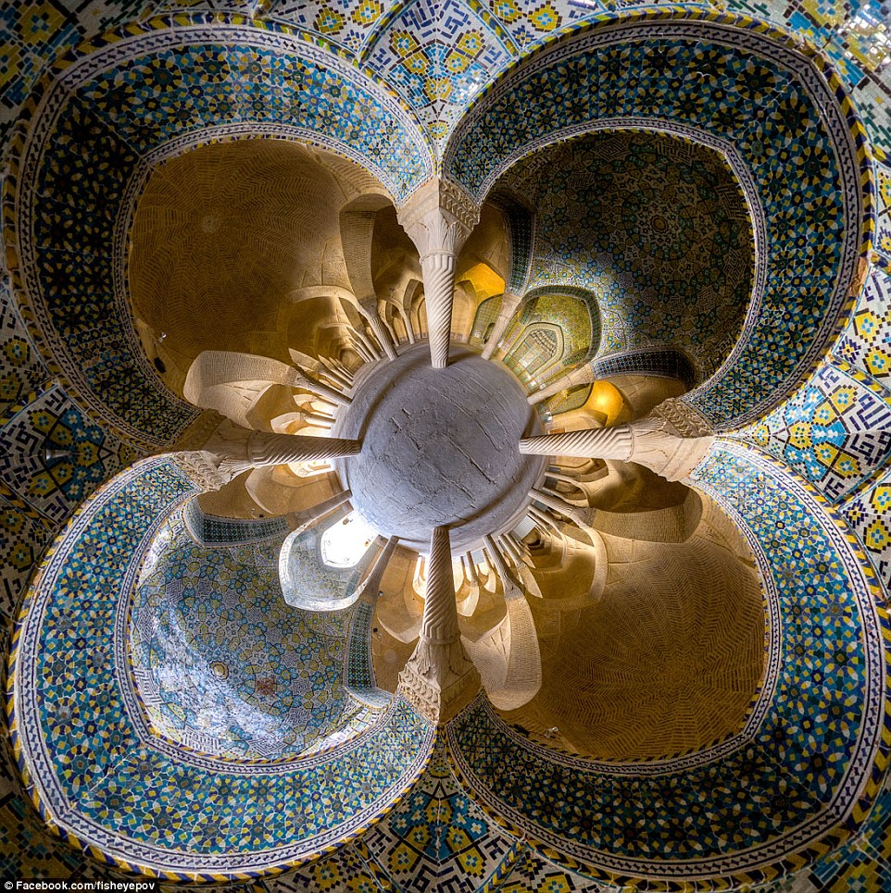
Types of Kaleidoscopes
Hand held
Cell / Wand
Parlor scopes
Jewelry
Sculptural (public art)
Architectural
Projection
Marble Scopes
Teleidoscopes

Slide 9
Anatomy of a Kaleidoscope
Eye Piece
Glass / Optical Magnifying Lens
Mirror System
First Surface Mirrors
Triangular / Rectangular / Polygon
Mandala / Full Field
Object Cell
Liquid / Dry
Shaker / Rotating
Front light or side light
Color Wheel / Wand / Marble
Notes:
Charles G(ustavos) Busch – dropped the C for his patents
parlor scopes
Made over 5000 scopes
Originally sold for $2, today 2-4 K
Scopes typically held 35 objects of which 1/3rd were liquid filled
While given credit for liquid filled objects, Brewster in 1819 mentions “differently moving fluids enclosed and moving in small vessels of glass will make the finest transparent objects for the kaleidoscope”. Which is why these objects can be found in early European scopes.

Slide 10
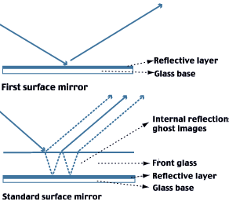
First Surface Mirror
Developed for Space Telescopes
Preferred for best optical quality in Kaleidoscopes
Only one company makes the mirror in USA. Nearly closed a year ago.

Slide 11
Trivia
“Kaleidoscope” is a combination of Greek words, KALO, EIDO, SCOPOS meaning beautiful-forms-viewer.
Inventor of Kaleidoscopes studied to be a minister, but quit after his first sermon
Kaleidoscopes can be made with any number of mirrors (including one), it’s just that more than 4 is difficult to assemble.
John C Campbell Folk School (Brasstown, NC) is converting a silo to a walk-in kaleidoscope
One of the countries largest kaleidoscope collections is located in Tennessee
1919 – Carpet company in Dalton GA had 4 people whose full time job was to look at Kaleidoscopes
The worlds largest Kaleidoscope shop is located in a ghost town – Nellie Bly Kaleidoscopes in Jerome, AZ
The most expensive kaleidoscope was sold at Sotheby’s for $75,000

Slide 12
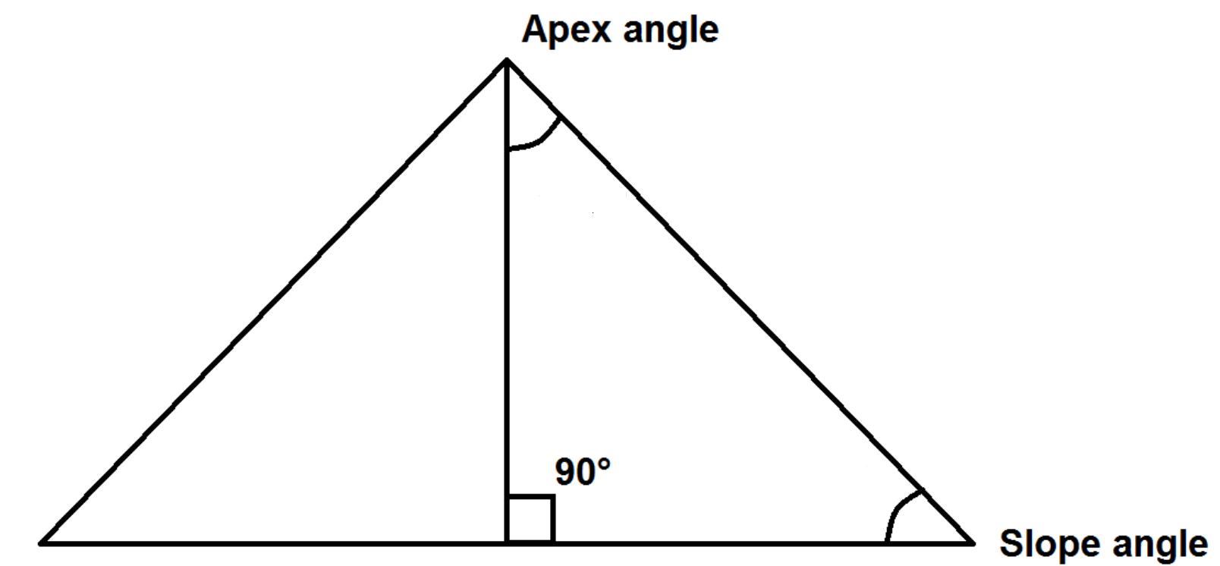
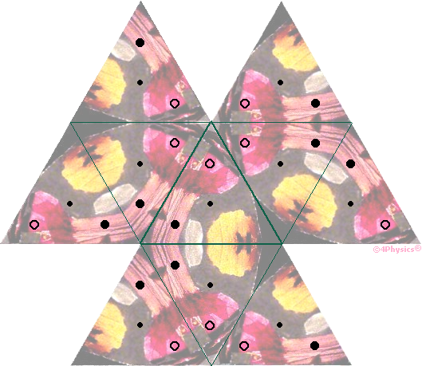
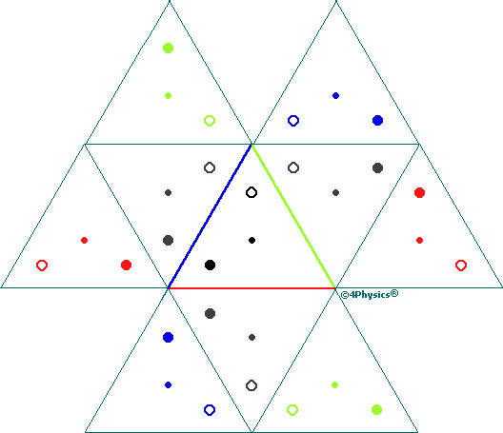
Math
Kaleidoscopes typically built on triangles
The sum of the angles in a triangle = 180
Equilateral triangles – each angle has the same angle (60)
Isosceles triangles – 2 angles are the same
Right triangles (30, 60, 90)
Angles of the mirrors determines the number of reflections viewed (smaller angle = more reflections.
The level of symmetry is calculated as:
360 / apex angle
The number of reflections calculated by:
(360º / Angle between mirrors)-1
The number of points is calculated by:
180 / apex angle
See https://www.4physics.com/phy_demo/ kaleidoscope/kaleidoscope-0.html for real theory / explanation

Slide 13
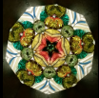
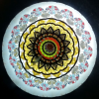
(Tri-) Angles and Points
The tighter the angle (smaller) the more points you will see in a mandala
Points in Star | Angle
3 | 60
4 | 45
5 | 36
6 | 30
7 | 25.7
8 | 22.5
9 | 20
Points in Star | Angle
10 | 18
11 | 16.4
12 | 15
13 | 13.8
14 | 12.9
16 | 11.25
18 | 10

Slide 14
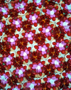
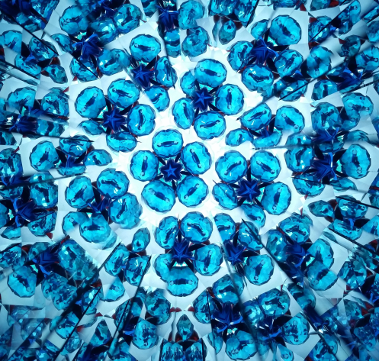
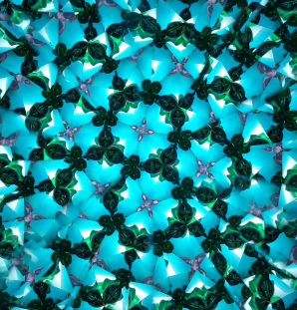
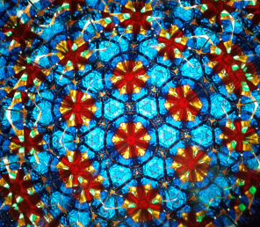
Full Field Images A Mandala Reflected Around Itself
3 point – Equilateral Triangle
4 point – Isosceles Right Triangle
5 Point – Right Triangle
6 Point – Right Triangle

Slide 15
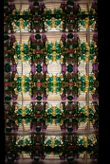
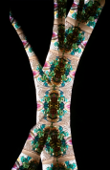
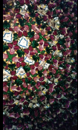
4 Mirror Scope Images
Square 4 Mirror
3 Mirror – Chorus Line
4 Mirror – Diamond
Drunken Chorus Line
Tree Spirit Chorus Line
Cherokee Headdress

